Slide 1
CHROMOSOME ALTERNATIONS/ABERRATIONS
Submitted to:-Prof. Pooja Verma
Submitted by:-Nandita Kumari
B.Sc ist yr.
Roll No. 6505

Slide 2
Chromosome alternation
These are the changes that occurs in number and sequence of genes in the chromosomes without altering their ploidy.
They were first analyzed by Muller (1928) in Drosophila with the help of polytene chromosomes and Ms Mc Clintock (1930) in Maize with the help of pachytene changes .

Slide 3
TYPES of chromosome alteration
Chromosome alternation
Changes involving number of genes
Changes involving the arrangement of genes
Inversion
Deletion
Duplication
Translocation

Slide 4
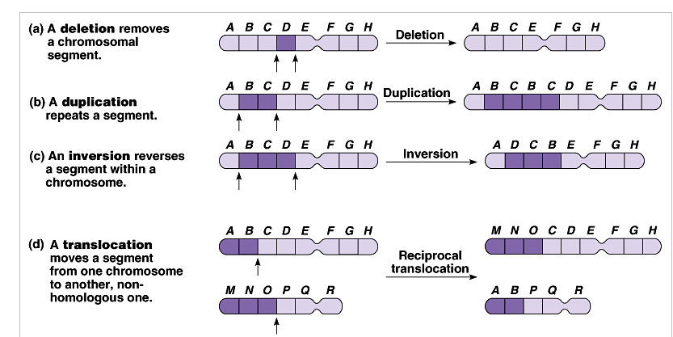
Chromosomes alterations

Slide 5
CHARACTERISTICS
1. It involves breaking of chromosome segments.
2. It can be induced with the help of ionising radiations and chemical agents.
3. They are usually irreversible.

Slide 6
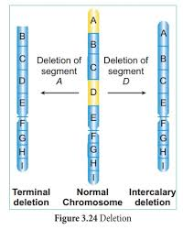
DEFICIENCY OR DELETION
Loss of a chromosome segment is basically a deletion
These may be terminal or intercalary.
TERMINAL DEFICIENCY: It is produced by a single break near the end of chromosome.
INTERSTITIAL OR INTERCALARY DELETION : It is produced by a double break in the chromosome , loss of interstitial segment followed by union in the regions of two breaks.

Slide 7
IMPORTANCE
Homozygous deficiency or deletion is usually lethal as some genes are completely lost from genotype.
Gametes bearing deficient chromosome may become functionless or sterile if some vital gene is lost.
In human beings deficiencies or deletions are known to produce a number of malfunctions, e.g. , chromosomes 18 (enlarged ears and fingers) ,5 (cat cry with small head and low mental ability) etc.

Slide 8
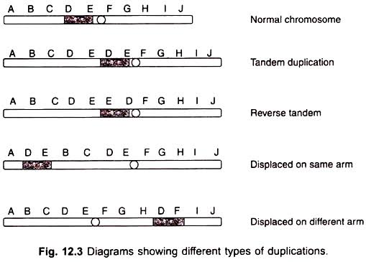
DUPLICATION
It is the phenomenon of having a similar extra chromosome segment in addition to the normal chromosome complement so that one or more genes are present in more than the normal dose.
It can be of five steps: extra chromosomal, tandem, reverse tandem, displaced and transposed.

Slide 9
IMPORTANCE
1. It increases the number of genes in a genotype.
2. It have a high degree of survival because they are seldom lethal.
3. It is useful in evolution because they add new genetic material.
4. It increases genetic redundancy.
5. Duplication of gene may sometime produce abnormalities or deleterious effect on one or more characters.

Slide 10
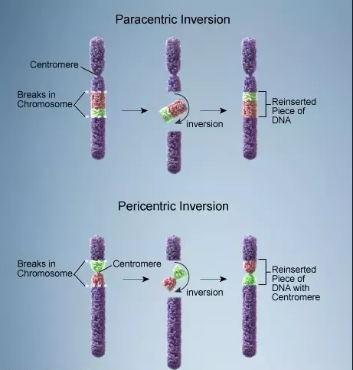
INVERSION
It is a type of chromosome aberration in which a segment of chromosome gets inverted or rotated on its axis by 180 degree so that the order of genes in this segment gets reversed.
There is neither a gain nor a loss in the genetic material but simply a rearrangement of the gene sequence.
It is of two types:
1.PARACENTRIC
2. PERICENTRIC

Slide 11
IMPORTANCE
Inversions, especially the paracentric ones, are the most common of all the chromosome alternation.
Inversion is useful in indefinite survival of particular gene group or group of chromosome segment.
They have helped in establishing species relationship in Drosophila.
Some inversions are of selective importance under certain environmental conditions.

Slide 12
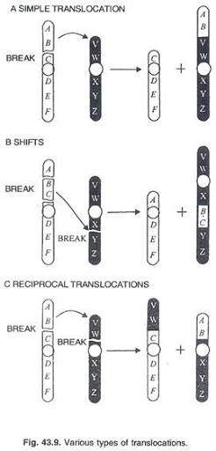
TRANSLOCATION
It is a type of chromosome aberration which involves separation of a chromosome segment and its union to a non homologous chromosome.
It does not involve any change in the total number of genes but there is change in the relative position of the genes.
It is of three types:
1.Reciprocal
2. Simple
3. Shift

Slide 13
IMPORTANCE
There is change in size or morphology of chromosomes. It ultimately leads to reproductive isolation.
It produces a large number of sterile gametes due to adjacent disjunctions when the chromosomes segregate in the ring state.
Translocation produces new linkage groups.

